Slide 1
Floridan Aquifer System Regional Groundwater Availability Study
Jason Bellino / David Sumner
FL AWRA Annual Meeting, Key Largo, FL
July 23, 2015

Slide 2
Project Staff
Jason Bellino; Lutz, FL – Primary Investigator
John Masterson; Northboro, MA – Senior Hydrologist & Project Advisor
Eve Kuniansky; Norcross, GA – SE Region GW Specialist
Mike Fienen; Madison, WI
Mark Nardi; Dover, DE
Betzy Reyes; Dover, DE
Mike Holmes; Lutz, FL
Joann Dixon; Orlando, FL
Jack Monti; Coram, NY
Jason Fine; Raleigh, NC
Notes:
Stress the nation-wide nature of the project team.

Slide 3
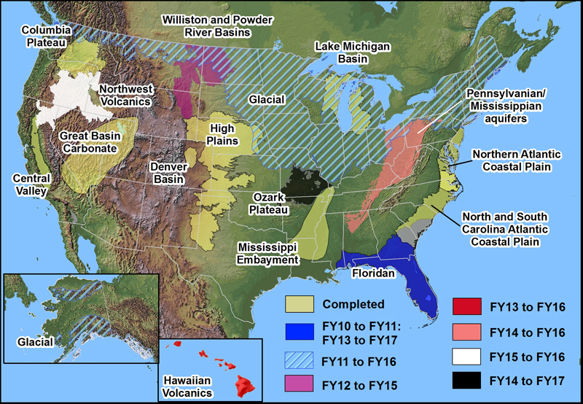
Introduction
Perspective:
Floridan study is just 1 of 15 current and completed studies across the county.
Funded by the USGS Groundwater Resources Program (GWRP), a national program to assess groundwater availability.

Slide 4
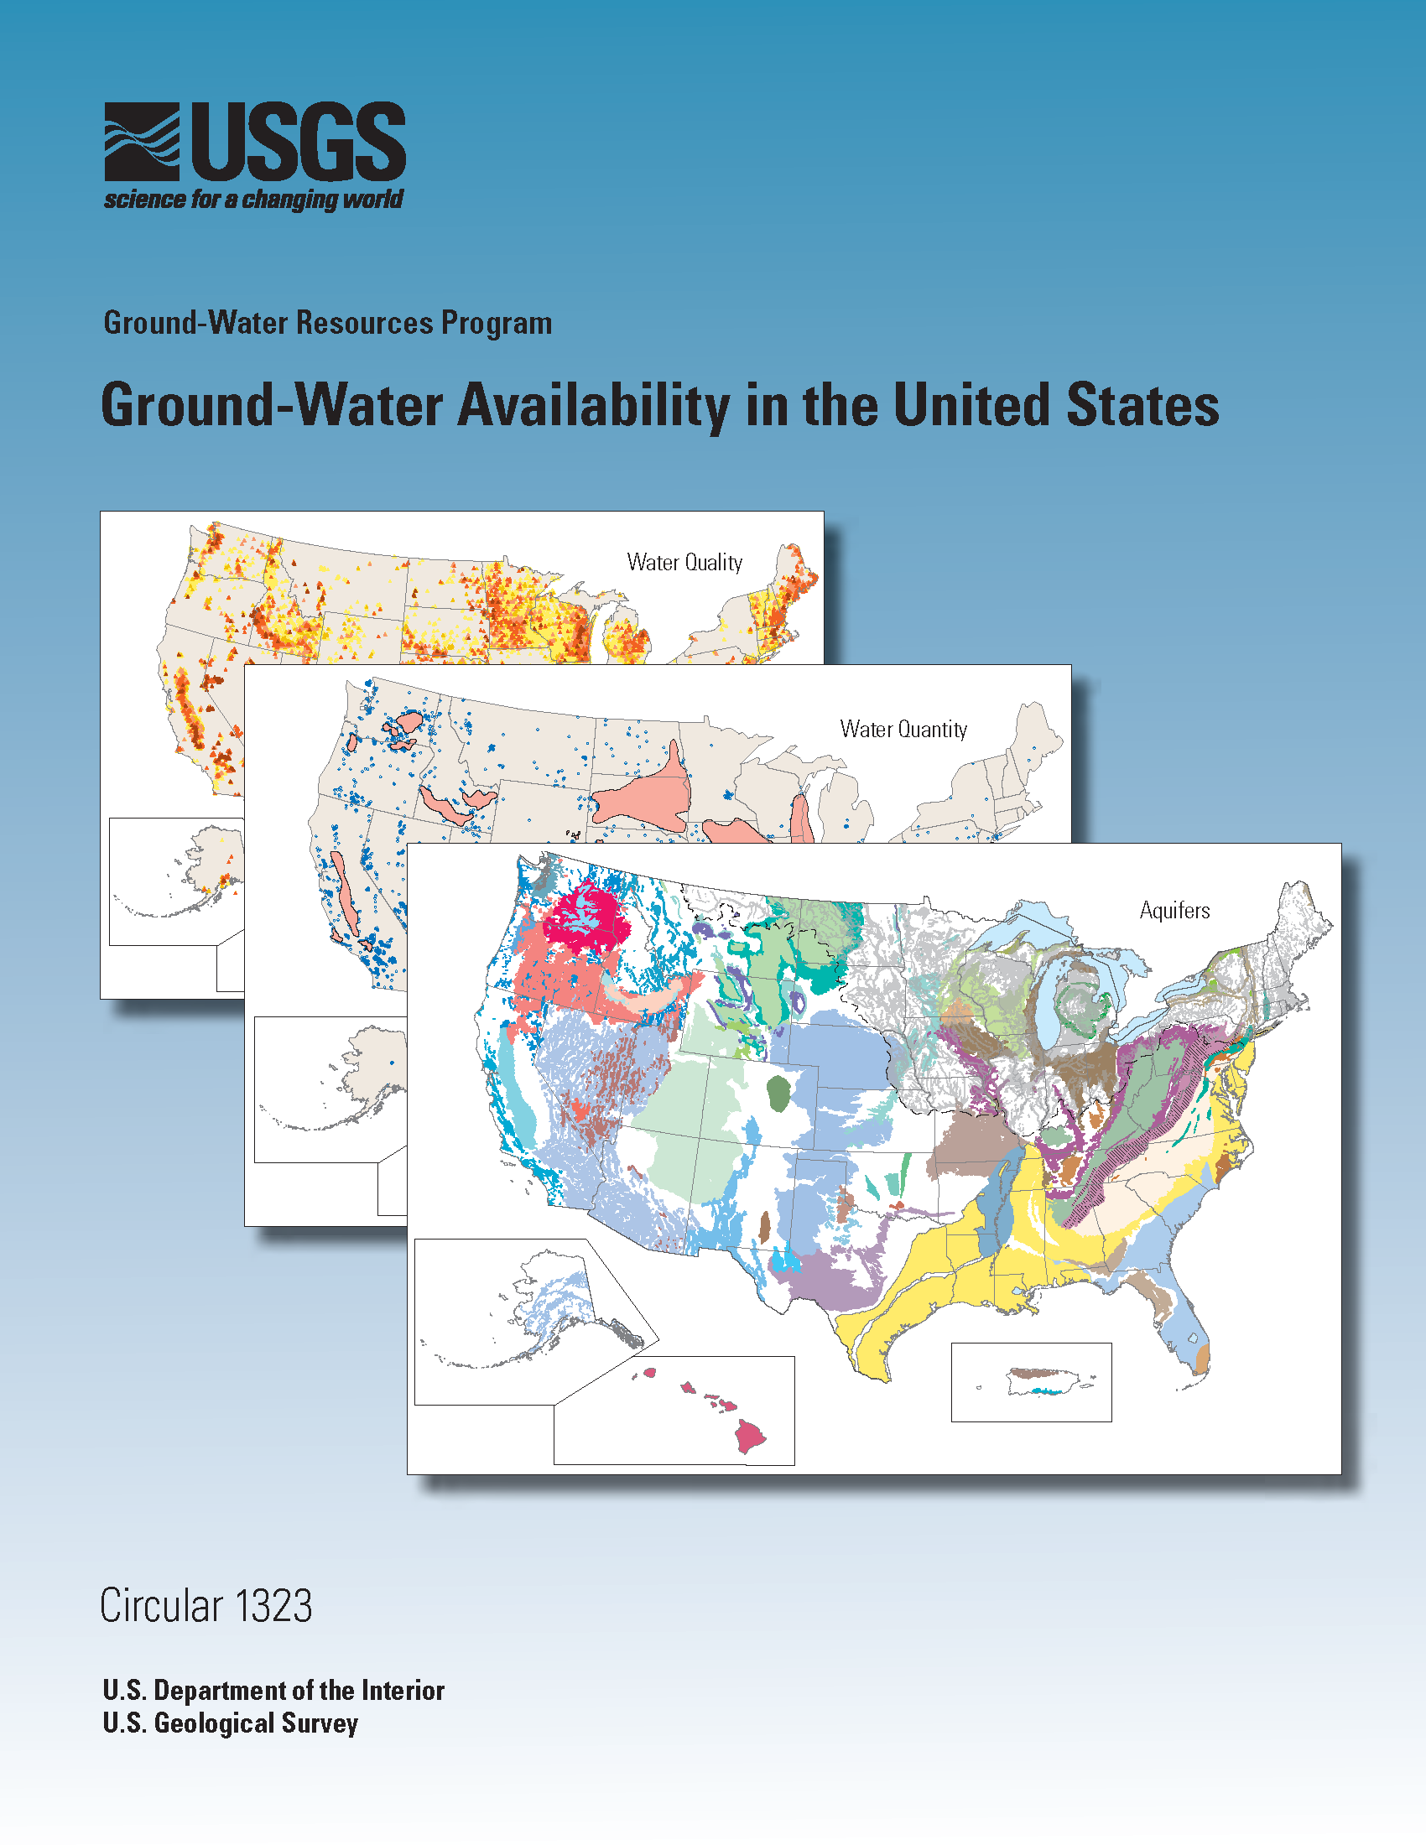
Objectives
Primary objectives of GWRP studies:
Quantify current aquifer resources,
Evaluate how those resources have changed over time, and
Provide tools to forecast how these resources will be affected in the future by changes in natural and anthropogenic stresses.

Slide 5
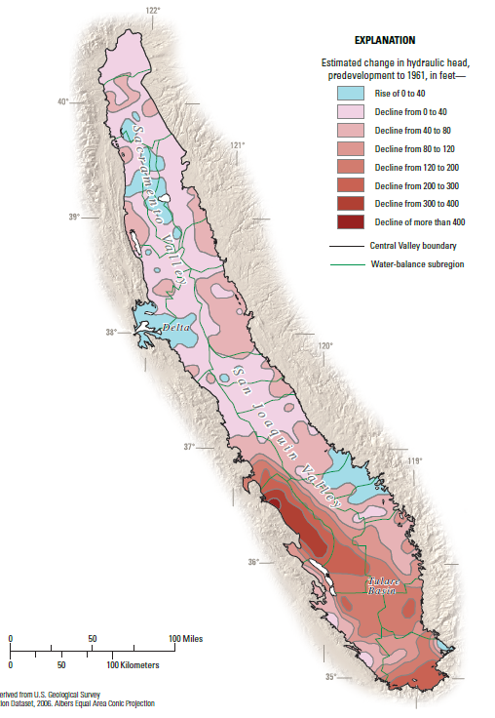
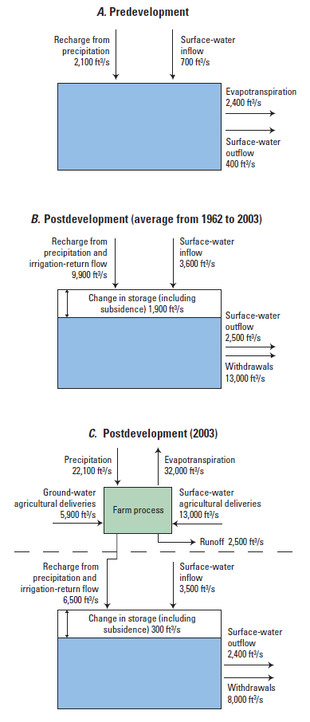
Objectives
hydraulic head change map
water budget
Meeting objectives 1 and 2
(quantify current resources and evaluate how they have changed over time)
Notes:
Example of some of the regional analyses from other GWRP-funded studies used to meet objectives 1 and 2 (quantify current aquifer resources and evaluate how those resources have changed over time)
Hydraulic head change map for the Central Valley aquifer (Faunt, 2009 [professional paper 1766])
Water budget comparison for the Atlantic Coastal Plain aquifer system from predevelopment to current period (from Reilly and others, 2008 [circular 1323])

Slide 6
Objectives
Meeting objective 3
(3) provide tools to forecast how these resources will be affected in the future by changes in natural and anthropogenic stresses
Develop a numerical model to predict how (changes in stresses)…
Weather variability (drought),
increased groundwater demand, and
sea-level rise
Will affect (issues of local concern)…
Groundwater depletion,
saltwater intrusion, and
groundwater divide migration.
Notes:
Numerical model will be developed to predict how (1) climate change (drought), (2) increased GW demand, and (3) sea-level rise will affect (a) groundwater depletion, (b) saltwater intrusion, and (c) groundwater divide migration.

Slide 7
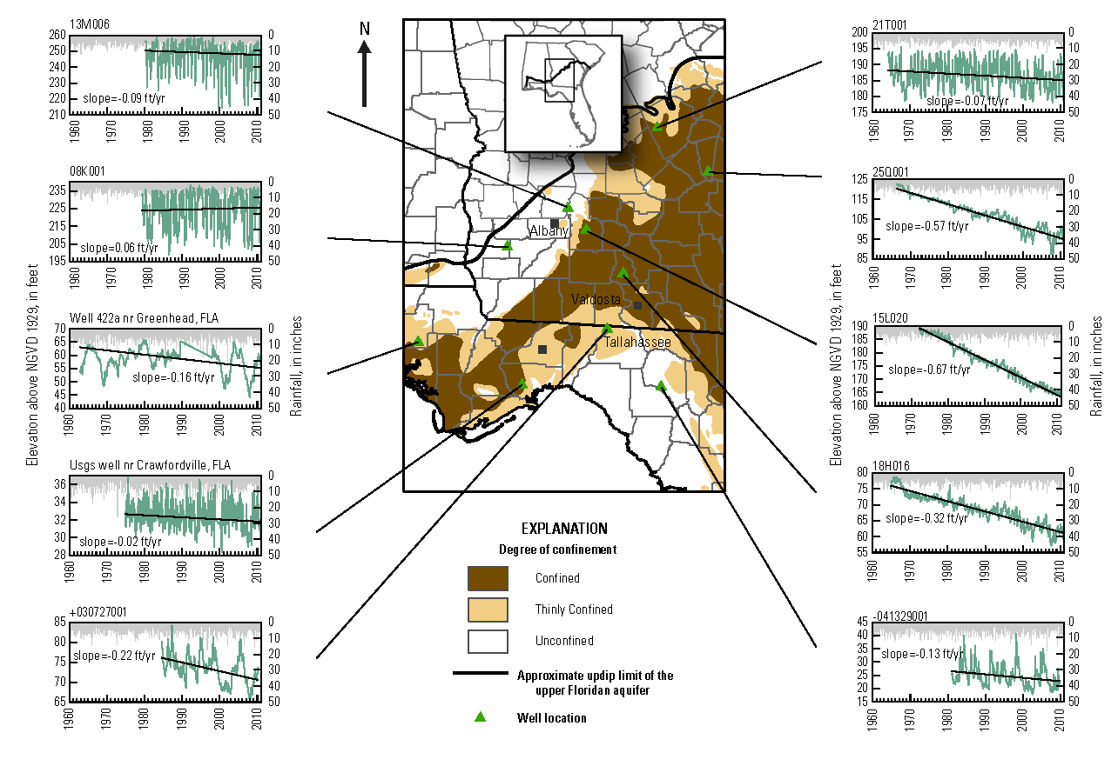
Objectives – Issues of Local Concern
Groundwater Depletion
3.5 cubic km of GW removed from storage in coastal Georgia and adjoining areas from 1900-2008 (Konikow, 2013)
http://pubs.usgs.gov/sir/2013/5079/
Notes:
Even though Konikows report is for coastal GA and SC, the decline in GW levels on this figure for SW GA is more apparent.

Slide 8
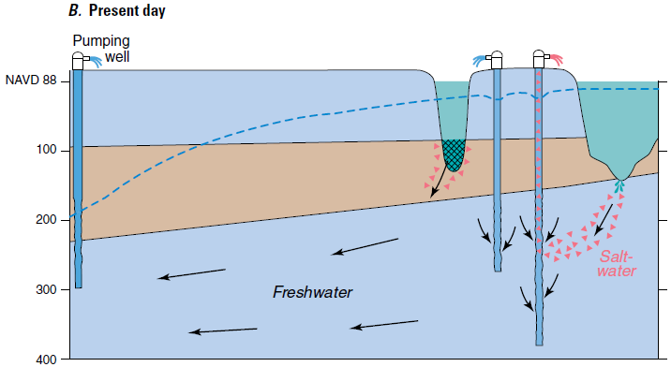
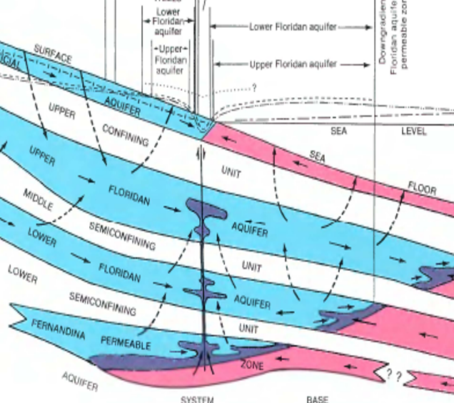
Objectives – Issues of Local Concern
saltwater intrusion via paleochannels near Hilton Head Island, SC (Provost et al, 2006)
Saltwater Intrusion
Public supply wells have become salinized in coastal areas of Florida, Georgia, and South Carolina caused by drawdowns associated with pumping.
upconing of saline water from base of system near Jacksonville, FL (Williams and Spechler, 2011)
Notes:
GA EPD recently (May 2013) put into effect a prohibition on new permits for withdrawals from the FAS in coastal GA counties (Chatham, Bryan, Liberty, and part of Effingham).
http://savannahnow.com/news/2013-05-22/state-prohibits-new-water-pumping-georgia-coast

Slide 9
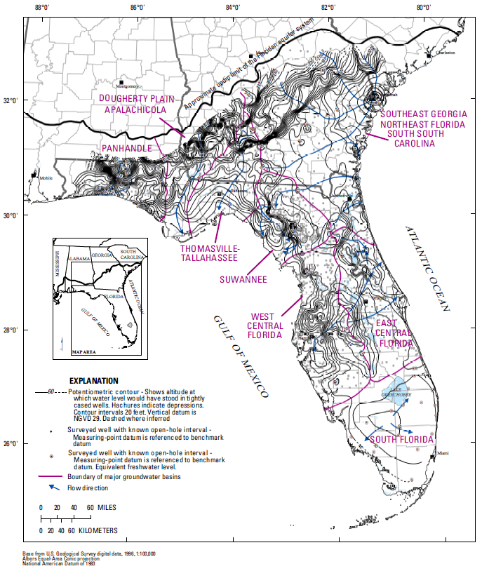
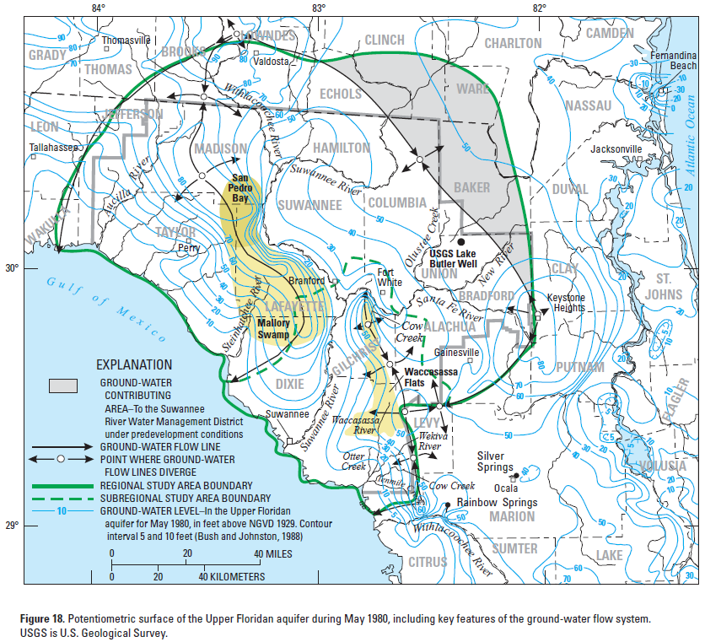
Objectives – Issues of Local Concern
GW Divide Migration
Debate about the extent to which groundwater divides have migrated and possible causes is ongoing in north Florida.
From Grubbs and Crandall, 2007
From Bellino and others, in press

Slide 10
Project Timeline
Notes:
Lots of work was started early on – mainly data compilation and analyses of groundwater levels. Revisions to hydrogeologic framework were started. Project went on hiatus for about 2 years after the first PI left. Previously started work continued and was wrapped up and published where applicable. Second phase of work started in FY13 with new PI and focused on assessing hydrologic conditions of the FAS. Second hiatus period following the departure of PI #2. Third phase of work has begun with 3rd PI (has been working on the project since it’s inception in 2010) and will wrap up with GW availability assessment in FY17/18.

Slide 11
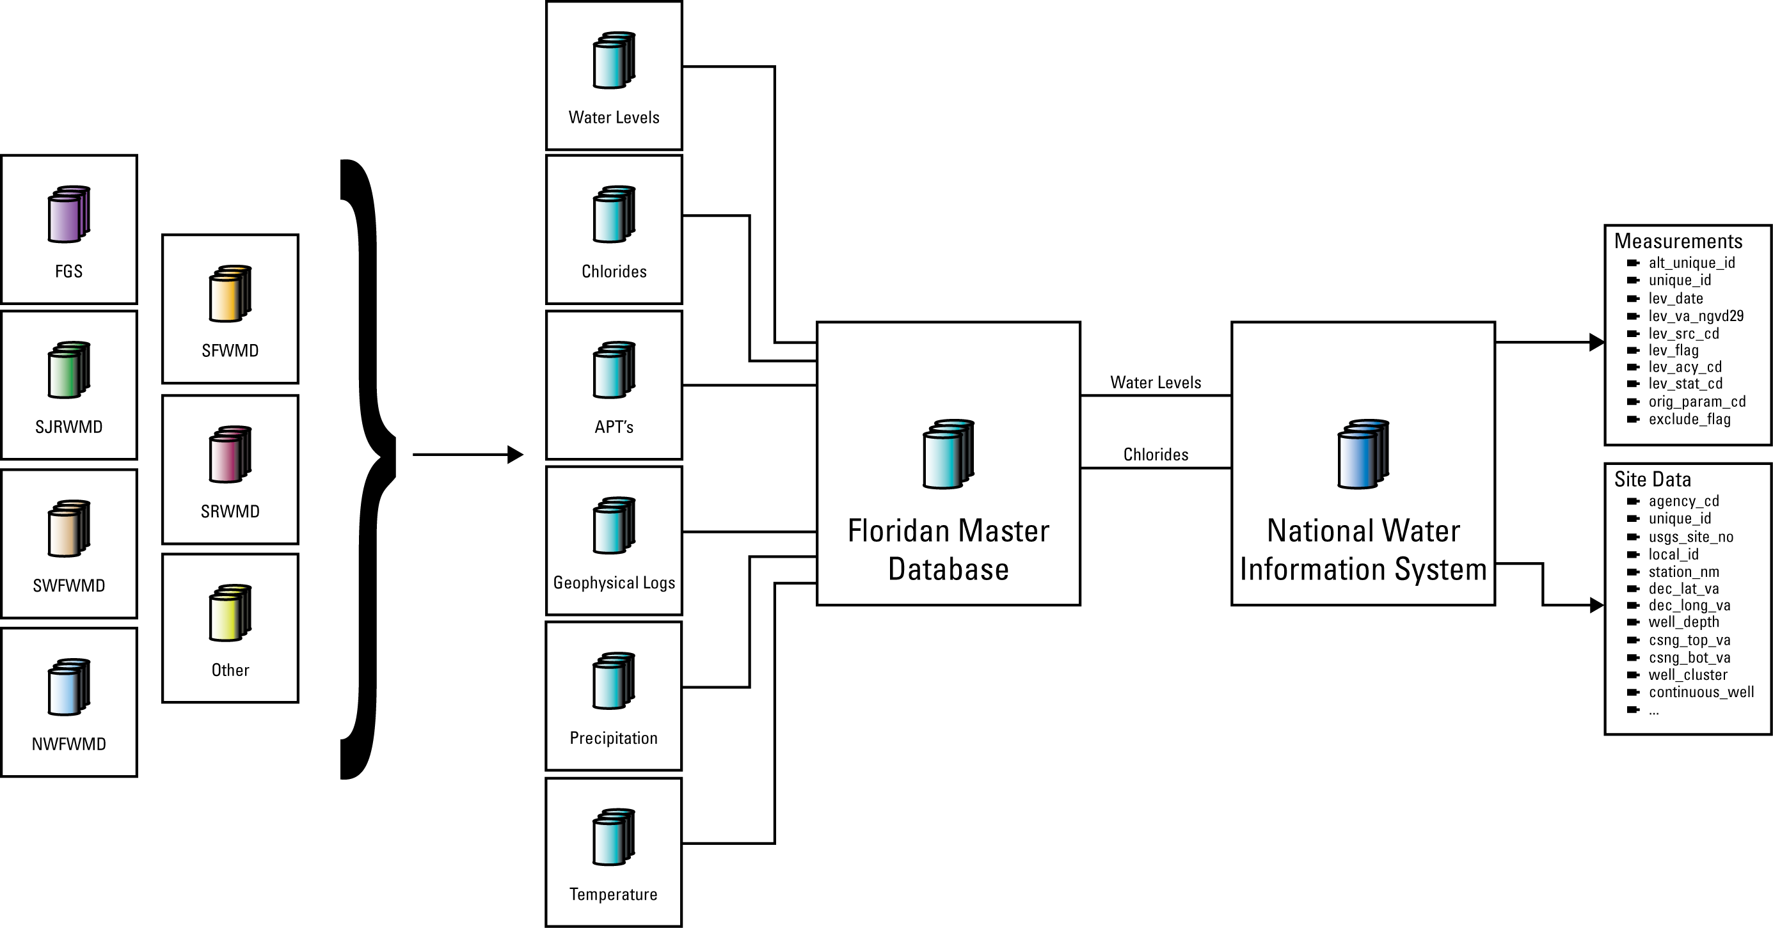
Project Status – Completed Work
Data Compilation
Notes:
Many of these datasets are available as stand-alone USGS products. See website for list of published products.

Slide 12
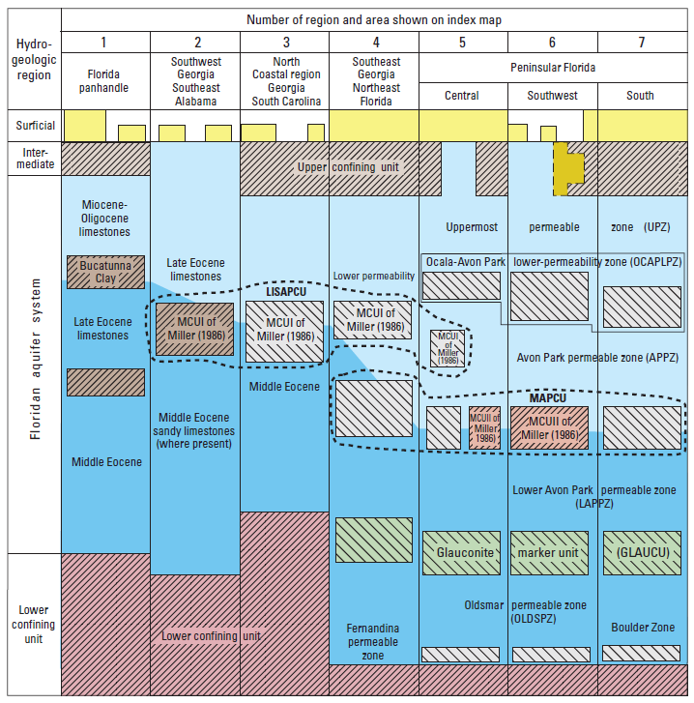
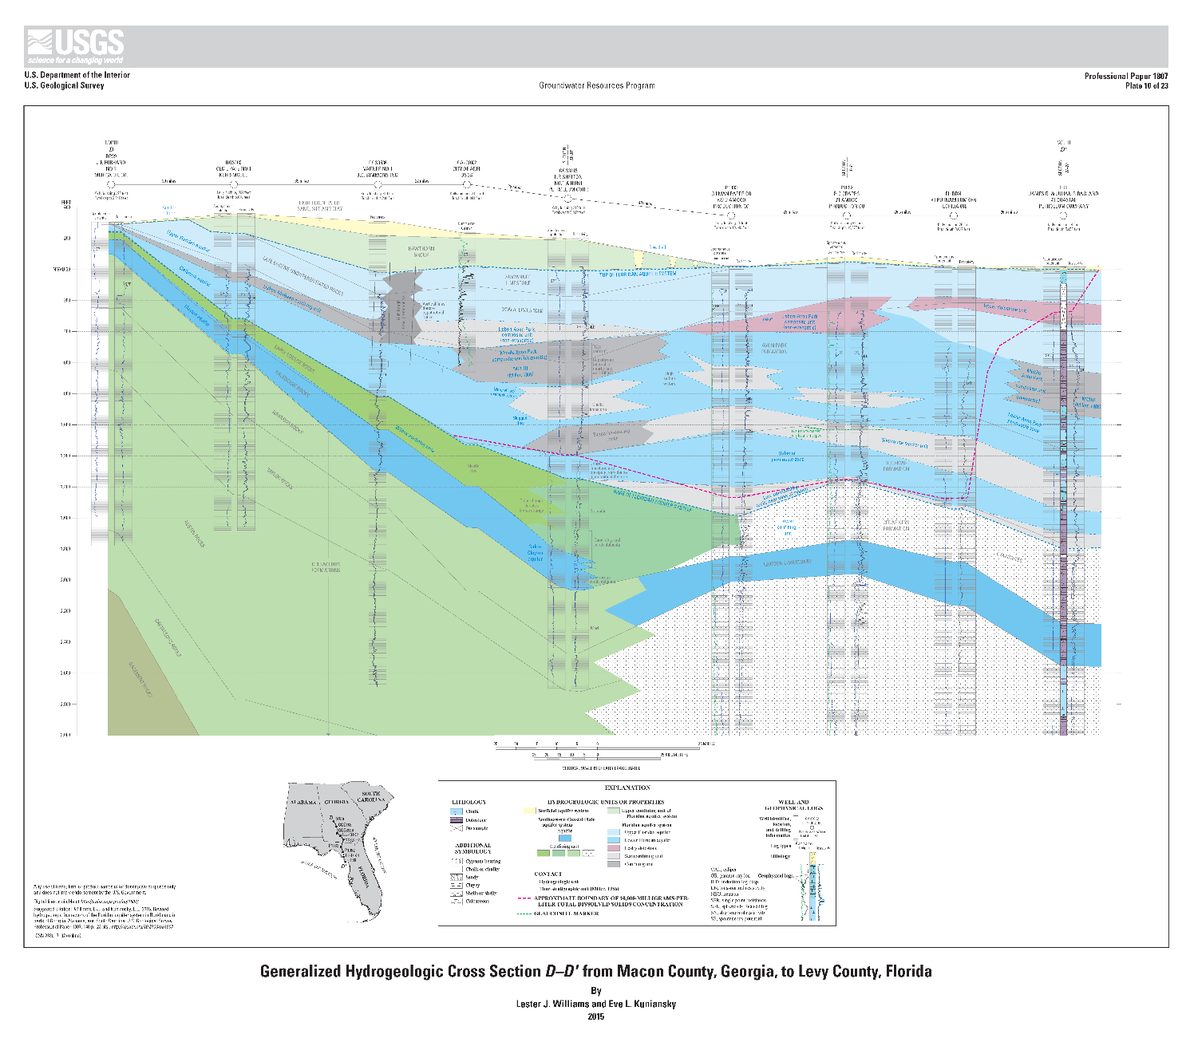
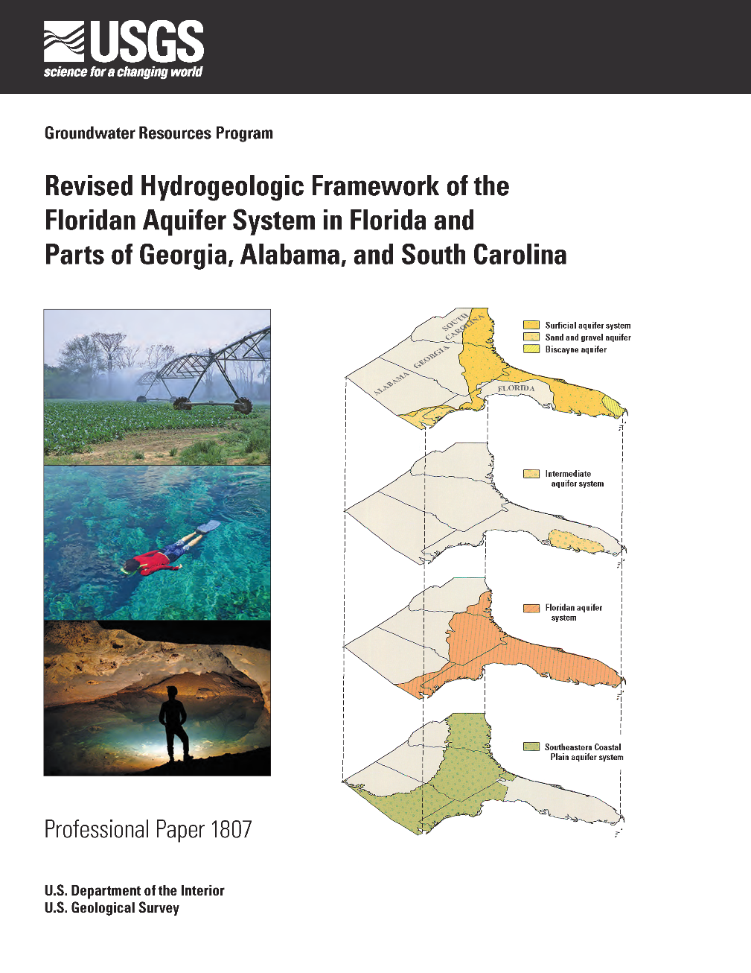
Project Status – Completed Work
Hydrogeologic Framework
Williams and Kuniansky, 2015
Revised by incorporating new studies and data
Remapped UFA/LFA boundaries using regional lithostratigraphic correlations (no more MCUs):
Bucatunna Clay confining unit
Lisbon-Avon Park composite unit
Middle Avon Park composite unit
Notes:
Remapping means that upper Floridan is now separated from the lower Floridan across the entire study area; no more discontinuous numbered middle confining units.

Slide 13
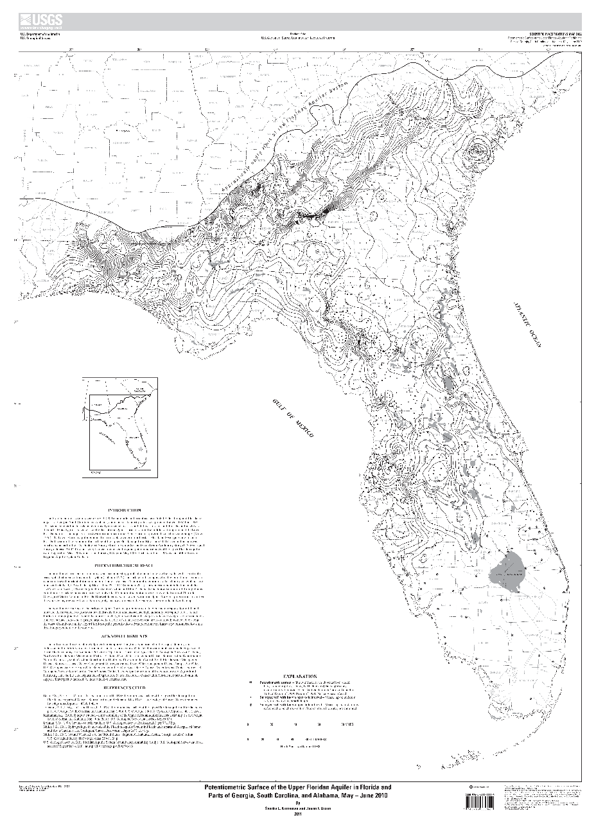
Project Status – Completed Work
Potentiometric Surface Map, May-June 2010
Kinnaman and Dixon, 2010
http://pubs.usgs.gov/sim/3182/
Notes:
Revised to include equivalent freshwater head data in south Florida, to be published in forthcoming SIR (Bellino and others, in review).

Slide 14
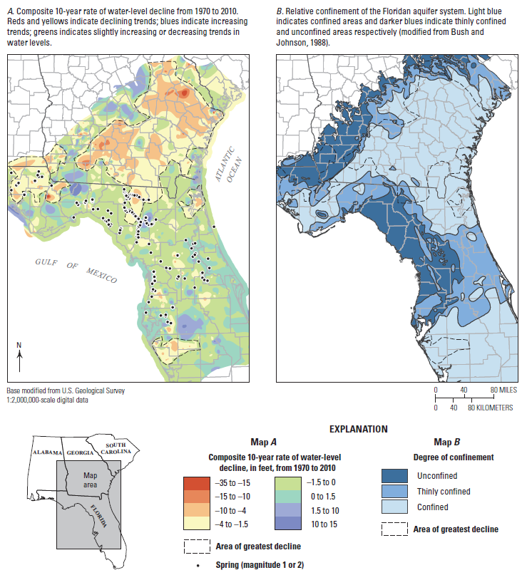
Project Status – Completed Work
Groundwater-Level Analysis
Williams and others (2013)
Relates areas of confinement with water level declines over time.
greater confinement = greater declines

Slide 15
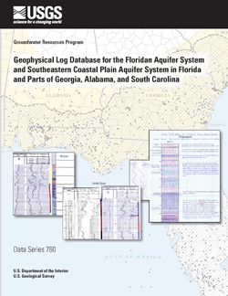
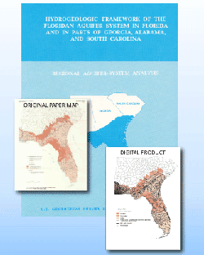
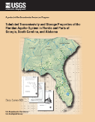
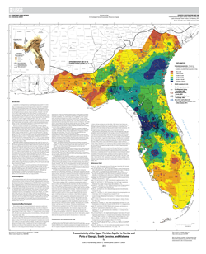
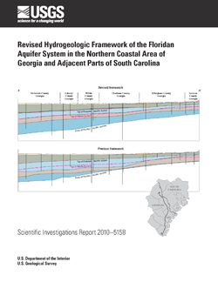
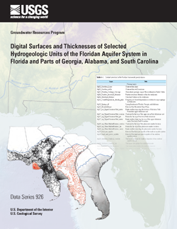
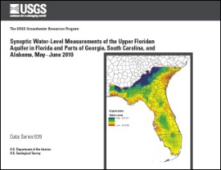
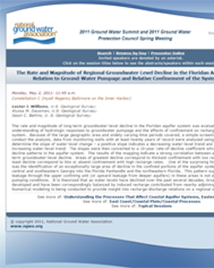
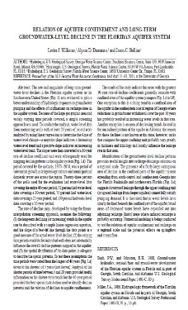
Project Status – Completed Work
Other Products
Data series releases
Digitization of Miller (1986) framework
Water level measurements used in the 2010 potmap
GIS dataset to accompany newly revised framework report
Geophysical log database
Tabulated aquifer properties database
Scientific Investigations Map of transmissivity of the UFA
Revised framework of the FAS in northern coastal GA and adjacent SC
Various proceedings papers and conference presentations

Slide 16
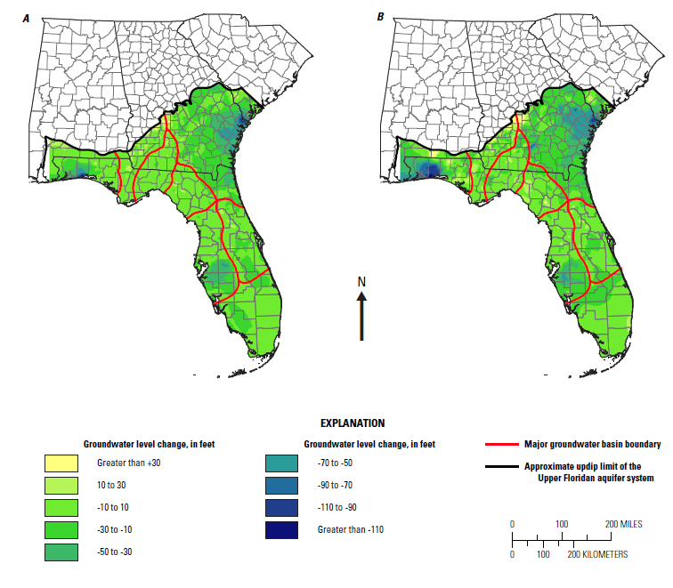
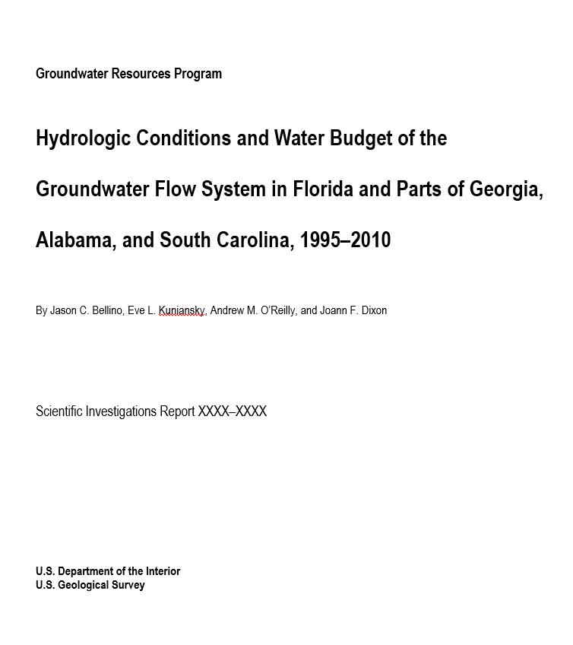
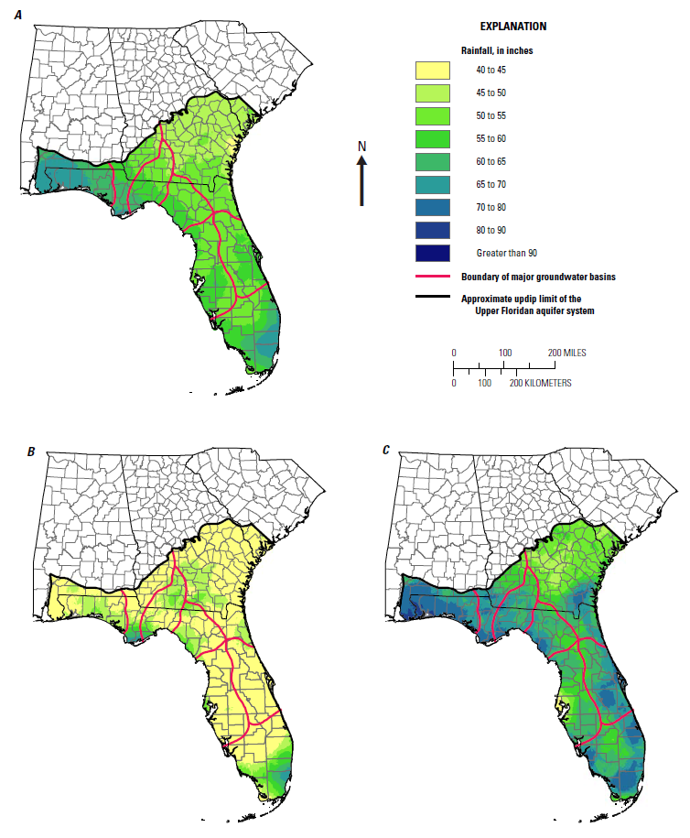
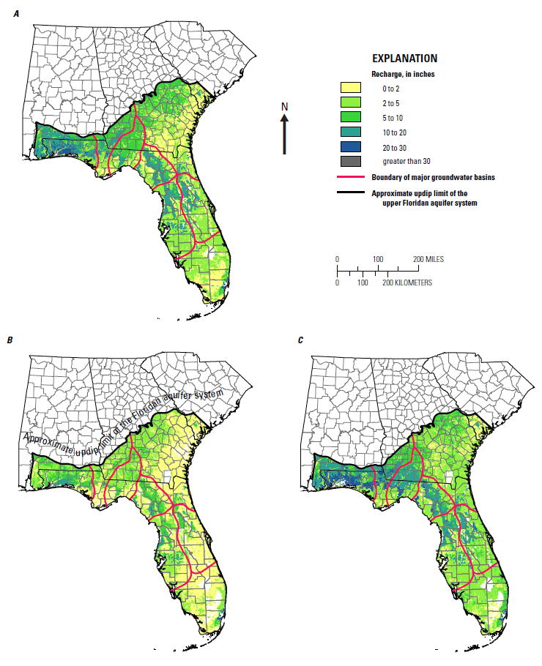
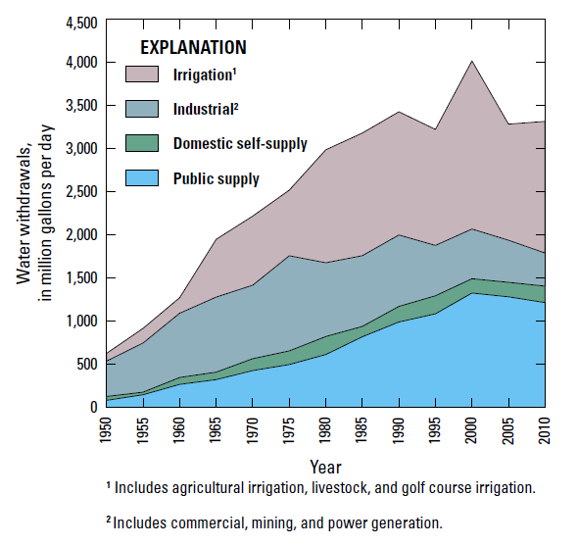
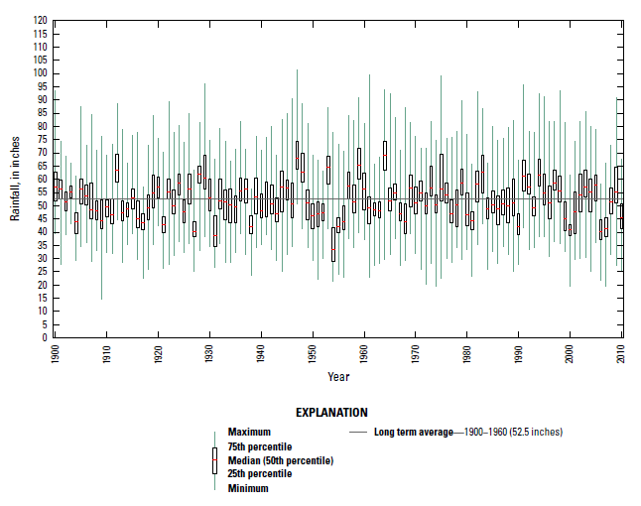
Project Status – Current Work
Hydrologic Conditions Assessment
Provides a current state-of-knowledge on the hydrologic conditions of the FAS
Conceptual model
Precipitation
Recharge
Water use
Spring flow
Change in storage

Slide 17
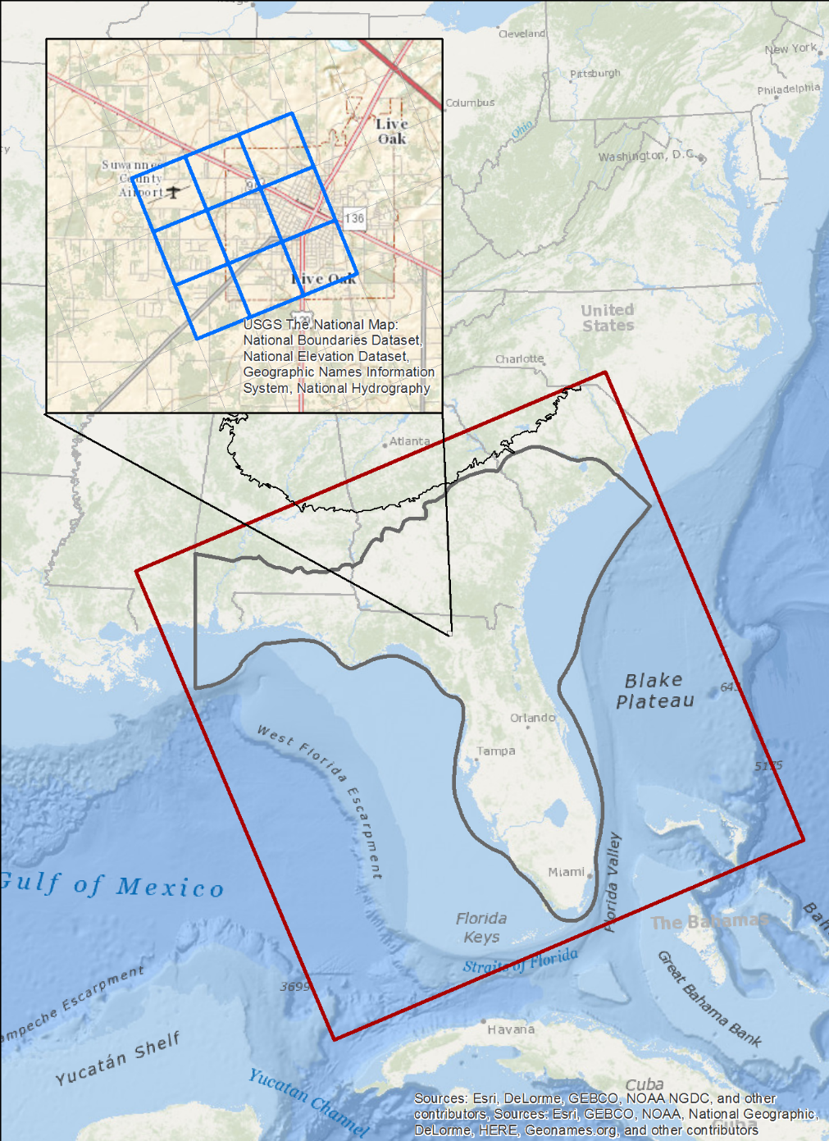
Project Status – Current Work
Numerical Model
Model domain will cover the entire FAS with a 5,000 ft by 5,000 ft uniform grid
9 layers including active surficial and confining units
Transient calibration from 1900-2010, with emphasis on the period from 1995-2010
Notes:
Residuals prior to 1995 (when data availability is not as good) will be zero-weighted – we can use the information to see how the model is responding without allowing it to affect the calibration.

Slide 18
Project Status – Current Work
Assessment of Groundwater Availability
What do we mean by groundwater “availability"?
The SECURE Water Act of 2009 (P.L. 111-11):Sec. 9508 establishes the "National Water Availability and Use Assessment Program" with the goals of:
providing a more accurate assessment of the status of water resources,
assisting in determination of the quantity of water that is available for beneficial uses, and
identifying long-term trends in water availability.
Notes:
Background information on the use of the term “Groundwater availability”

Slide 19
Project Status – Current Work
Assessment of Groundwater Availability
What do we mean by groundwater “availability"?
We are assessing effects of stresses and trends (water budgets and head change maps)
Not prescribing "how much" is available in a regulatory sense

Slide 20
Project Status – Planned Products
USGS Scientific Investigations Report on current hydrologic conditions of the Floridan aquifer system (Bellino and others, in press)
USGS Data Series release of estimated recharge from 1900-2010 (2017)
USGS Professional Paper outlining our assessment of groundwater availability with model documentation (2017/2018)
USGS Fact Sheet with major findings from the above Professional Paper (2017/2018)

Slide 21
Webpage

Slide 22
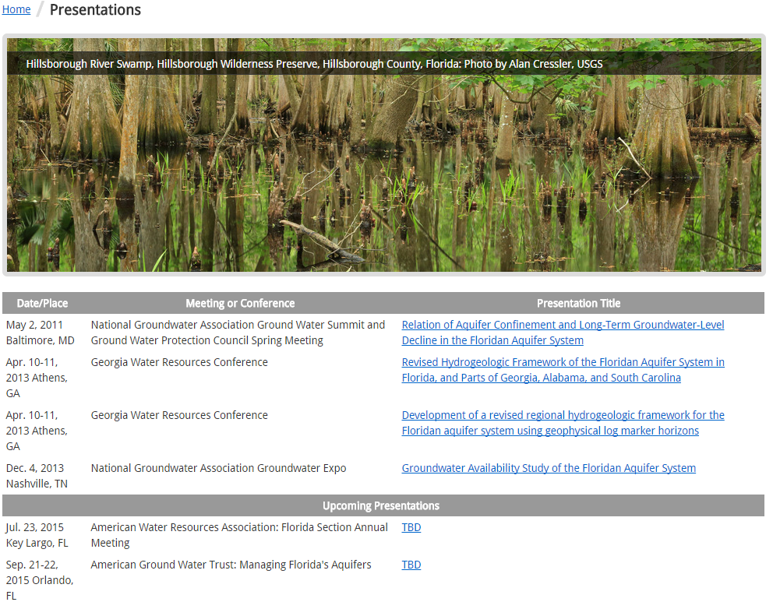
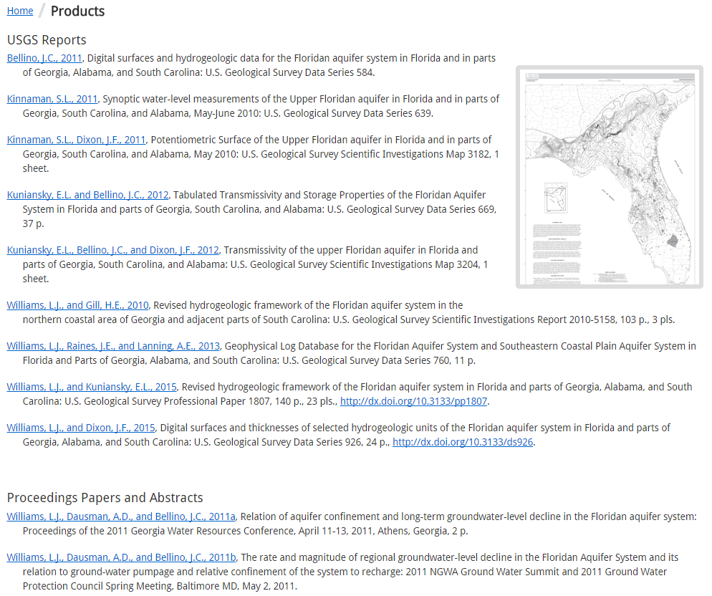
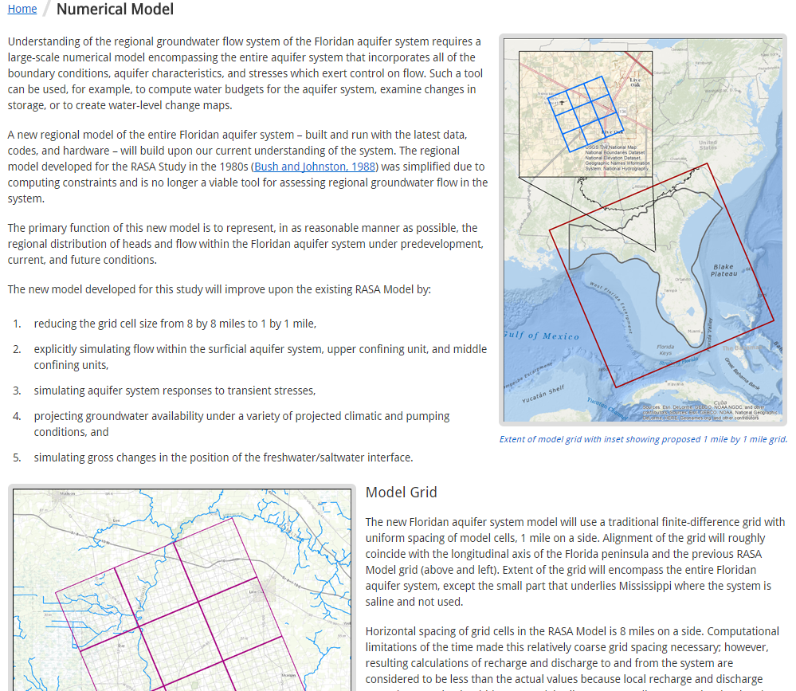
Webpage
www.fl.water.usgs.gov/floridan
Notes:
Floridan website contains information on objectives, approach, and timeline as well as project products and presentations and the numerical model.

